Slide 1
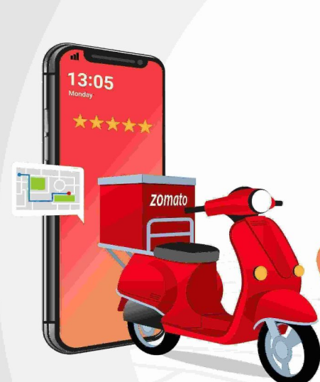
ZOMATO
RESTAURANT
ANALYSIS
Leveraging Analytics to Drive Market Expansion
and Customer Satisfaction
-KAVYA R

Slide 2
  INTRODUCTION
  PROJECT BACKGROUND & BUSINESS OBJECTIVES
  DATA REQUIREMENTS & UNDERSTANDING
  METHODOLOGY
  KEY FINDINGS & DATA-DRIVEN INSIGHTS
  DASHBOARD
  RECOMMENDATIONS
  CONCLUSION & NEXT STEPS
TABLE OF
CONTENT

Slide 3

INTRODUCTION
  Zomato is a global platform for restaurant
discovery and food delivery.
  It offers restaurant listings, customer reviews,
and online ordering.
  Uses data analytics to enhance customer experience
and business decisions.
  Sales analysis identifies trends based on location,
pricing, and demand.
  Evaluates the impact of online delivery, table bookings,
and customer preferences.

Slide 4

PROJECT BACKGROUND & BUSINESS PROBLEM
  Company: Zomato - A global restaurant discovery
and food delivery platform.
  Business Problem: The company needs to identify
new growth opportunities and improve customer retention
in a competitive market.
  Business Requirements :
  "We want to expand into new, high-potential markets."
  "We need to understand what drives customer satisfaction to improve our platform's offerings."
  "We must optimize our services (delivery, booking) to increase engagement."

Slide 5
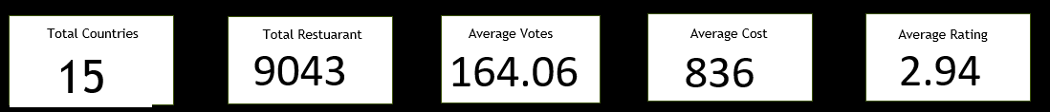
DATA REQUIREMENTS & UNDERSTANDING
Objective: To source and prepare a dataset that allows for market and
customer behavior analysis.
Dataset Overview (The "What"):
  Scope: 9,043 restaurants across 15 countries.
Key Attributes (The "How"):
  Business Data: Location, Cuisine, Price for two.
  Operational Features: Online Delivery, Table Booking.
  Customer Engagement Metrics: Aggregate Ratings, Number of Votes.
  Data Preprocessing :
  Handled missing/invalid data (e.g., coordinates, currency conversion to INR).
  Standardized city/country names for consistency.

Slide 6

METHODOLOGY
  Exploratory Data Analysis (EDA): Used Pivot Tables and functions (Vlookup, Countifs, Average, Conditional Formatting) to identify basic trends.
  Comparative Analysis: Benchmarked countries, cuisines, and services against key metrics (ratings, cost, votes).
  Gap Analysis: Identified disparities between high-performing
and low-performing markets/features.
    Example Gap: "High-rated cuisines like Sushi are under-represented in low-competition markets."
  SWOT Analysis : Structured findings into Strengths,
Weaknesses, Opportunities, and Threats.

Slide 7
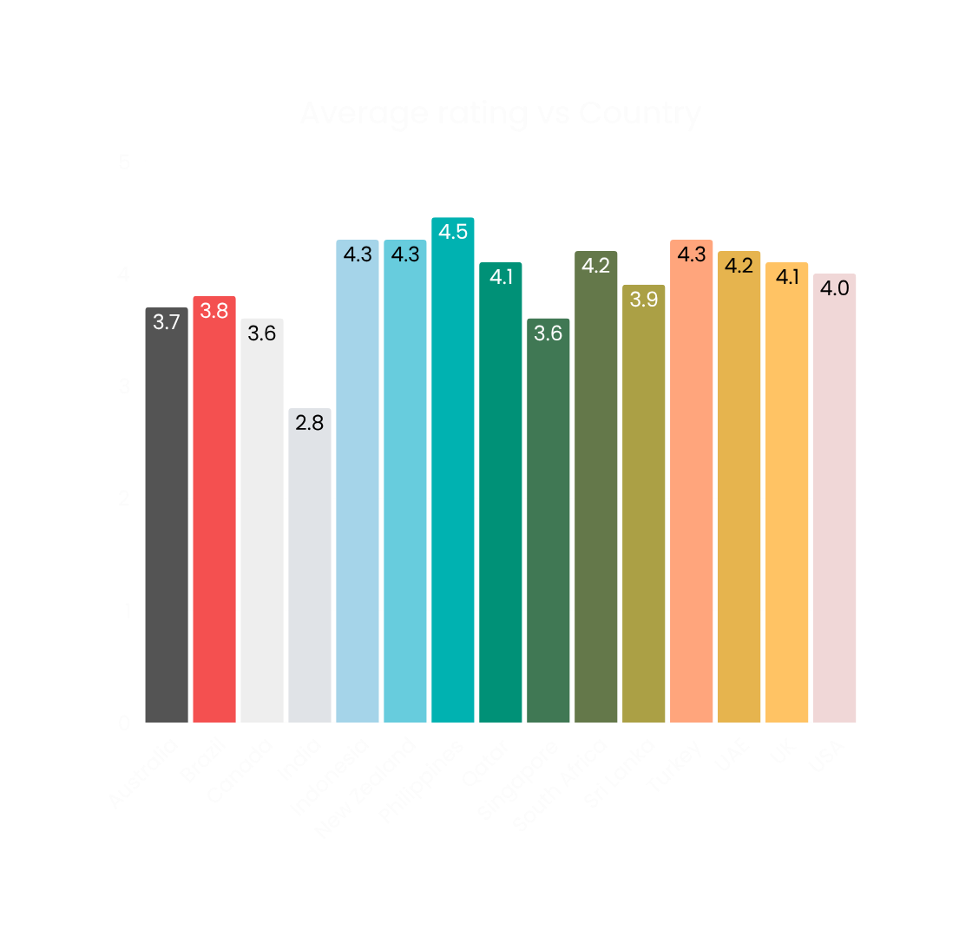
GEOGRAPHIC MARKET ANALYSIS
FINDINGS:
  Not all markets are equal. We can prioritize expansion based on data.
RECOMMENDATIONS:
  Opportunity: Enter the Philippines and Indonesia (High Ratings, indicating strong customer satisfaction).
  Strategic Move: Target Sri Lanka (Lowest competition, significant scope for improvement and market capture).
  Turkey and New Zealand (Growth potential, moderate competition good customer satisfaction).

Slide 8
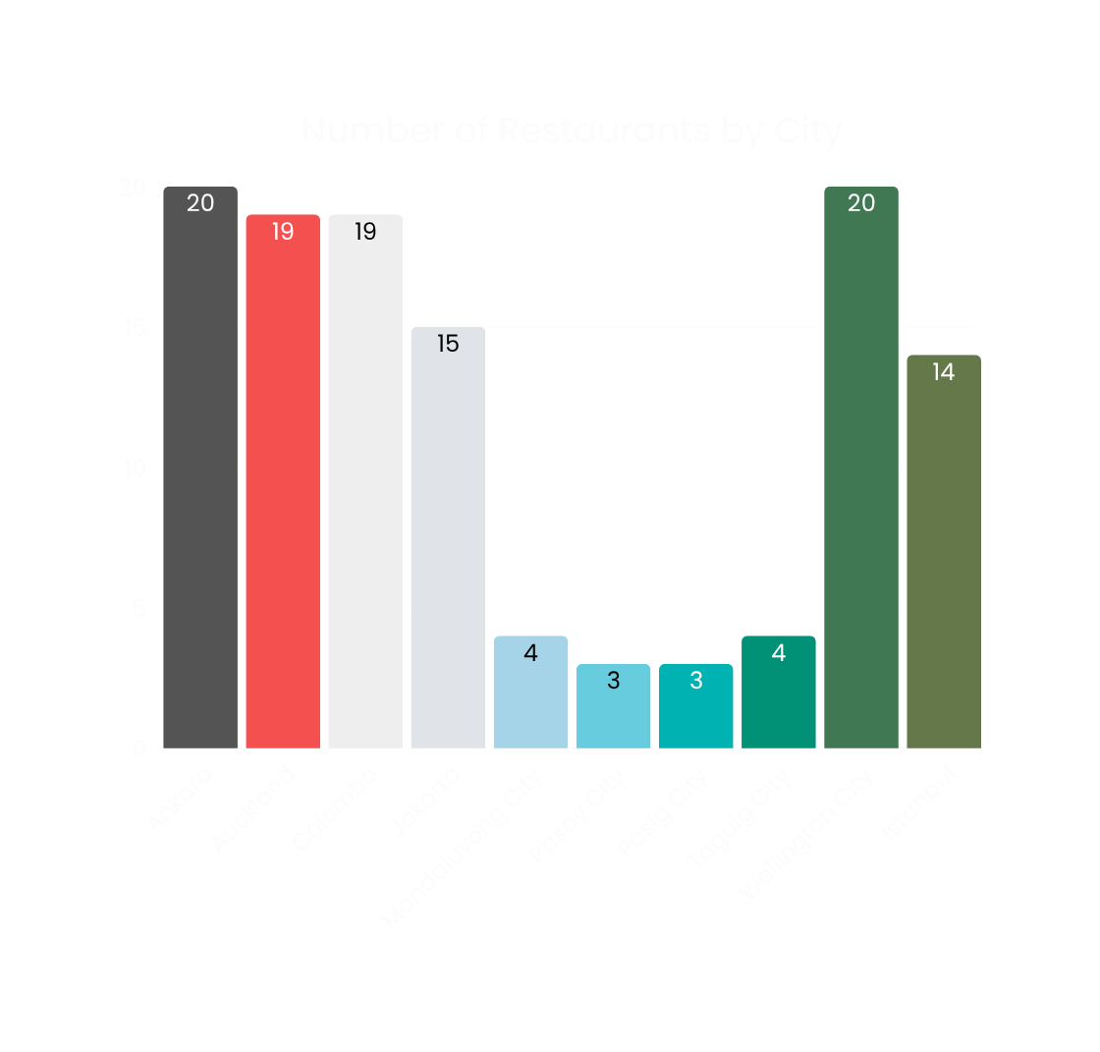
RECOMMENDED CITIES
  Indonesia:Jakarta, Tangerang.
  NewZealand:Auckland, Wellington.
  Philippines:QuezonCity, Makati City.
  Sri Lanka: Colombo.
  Turkey: Ankara, Istanbul.

Slide 9

GROWTH TRENDS & MARKET EVOLUTION
1. Diagnose Peaks & Troughs
  Investigate root causes for 2018 success and 2016 decline
  Learn from both high and low performance periods
2. Recognize Market Volatility
  Fluctuations indicate external sensitivity
  Prepare for unpredictable market shifts
3. Identify Strategic Pivots
  2018 rebound signals successful strategy change
  Document what worked for future planning

Slide 10
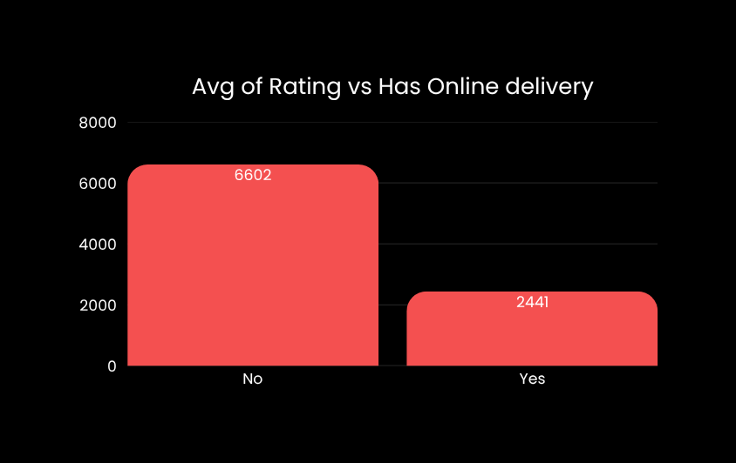

SERVICE QUALITY GAP
FINDINGS:
Core platform services significantly impact customer satisfaction.
RECOMMENDATIONS
  Gap Identified:
Restaurants without these features have lower ratings.
  Business Requirement:
Incentivize and onboard more restaurants to offer Online Delivery and Table Booking.

Slide 11

FOOD EXPENDITURE ANALYSIS BY COUNTRY
FINDINGS
  Clear price tiers: Budget (Turkey), Mid-Range (Indonesia), Premium (Philippines).
  High cost ≠ high rating: Singapore is most expensive but not highest rated.
RECOMMENDATIONS
  Segment market entry strategy for each price tier.
  Compete on quality in premium markets, value in budget markets.
  Create tiered partnership models with flexible commission rates.

Slide 12

CUISINE STRATEGY
FINDINGS:
Cuisine type is a major driver of customer ratings.
RECOMMENDATIONS:
  Opportunity: Promote high-rated cuisines (Seafood, Desserts) on the platform's homepage and campaigns.
  Risk Mitigation: Investigate why popular cuisines like North Indian and Chinese have low ratings (e.g., quality control, delivery time).
  Action: Work with restaurant partners to create "Quality Guidelines" for underperforming cuisines.

Slide 13
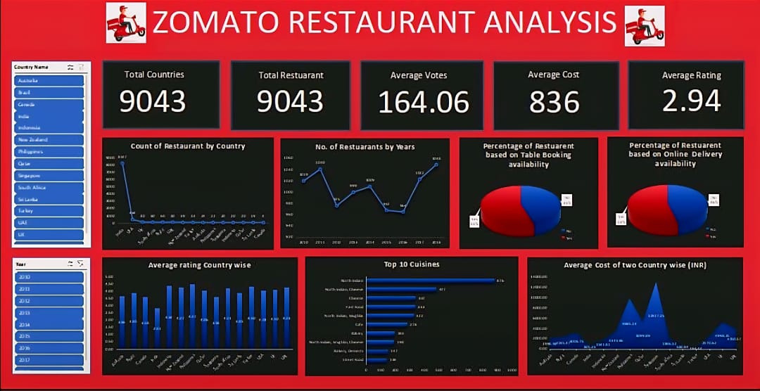

Slide 14
SWOT ANALYSIS SUMMARY
S: Strengths:
  Strong market presence in India.
  High customer engagement in key markets (Indonesia, UAE).
W: Weaknesses:
  Missing key services (table booking, delivery) in many restaurants
  Low-rated popular cuisines (North Indian, Chinese) risk brand perception.
O: Opportunities:
  Expand into high-satisfaction, low-competition markets (Philippines, Sri Lanka).
  Promote high-rated, affordable cuisines to improve value perception.
T: Threats:
  Competitors capturing market share in emerging countries.
  Inconsistent customer experience due to service and cuisine quality gaps.

Slide 15

RECOMMENDATION
  Market Expansion: Prioritize entry into Philippines, Indonesia, and Sri Lanka.
  Service Enhancement: Launch a project to increase Online Delivery and Table Booking adoption among partner restaurants.
  Cuisine Strategy: Curate and promote high-rated cuisines (Seafood, Desserts) and investigate quality issues with low-rated cuisines (North Indian).
  Pricing Leverage: Since price and rating correlation is weak (0.238), focus marketing on "Quality at the Right Price" rather than competing on cost alone.

Slide 16

CONCLUSION & NEXT STEPS
  Conclusion: This analysis provides a clear, data-driven roadmap for Zomato to drive growth and improve customer satisfaction by focusing on specific markets, services, and culinary offerings.
  Next Steps :
    Monitor KPIs post-implementation to measure business impact and inform iterative improvements.
    Documentation: Create a detailed Business Requirements Document for the market expansion project.
    Collaboration: Work with the Development team to define technical requirements for promoting services and cuisines on the app.

Slide 17

THANK
YOU

